Slide 1
3. Social Media Text Analytics
Amit Aylani

Slide 2
Contents
Social Media Text Analytics -
Types of Social Media Text
Purpose of Text Analytics
Steps in Text Analytics
Social Media Text Analysis Tools

Slide 3
Social Media Text Analytics
Social media text analytics is a technique for extracting and analyzing business insights from the textual content of social media platforms.
It can be used to understand emotions and sentiments expressed in user-generated content related to a brand or product.
Text analytics has roots in various fields such as data mining and natural language processing.
It is useful for quickly and accurately understanding the vast volume of social media content generated by users.
Approximately 80% of data in organizations is textual, making text analytics an important tool for business intelligence.
e.g. Flyertalk.com yo kedar wassup?

Slide 4
Types of Social Media Text
Depending on nature of social media text , it can be classified as
Static Text
Dynamic Text

Slide 5
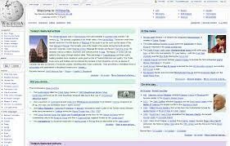

Static Text
Static social media text is typically longer in length and updated or deleted less frequently.
Examples of static text include wiki content, blog pages, Word documents, corporate reports, emails, and news transcripts.
The purpose of static text is often to inform, educate, and elaborate on a topic.
Static text can provide valuable insights and information for businesses and organizations.
Yo wassup?

Slide 6
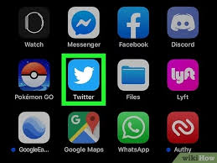
Dynamic Text
Dynamic text is real-time, user-generated text that expresses an opinion about content or information on social media.
It is typically shorter in length and diverse in nature, and is often updated or deleted frequently.
Examples of dynamic text include tweets, Facebook comments, and product reviews.
Dynamic text is often related to social, political, economic, personal, cultural, or business issues and expresses the views and feelings of the user.
Understanding dynamic text can provide valuable insights into the thoughts and opinions of social media users.

Slide 7
Social Media Dynamic Text Examples:
Social media text includes tweets, comments, discussions, conversations, and reviews.
Tweets are short messages (up to 140 characters) posted on Twitter, which may include text, images, video, or links.
Comments are written statements expressing opinions about content on social media.
Discussions take place through internet forums, which are organized by topic or thread and allow users to post questions and replies.
Conversations (or chatting) are instant exchanges of written messages between two or more people, often through dedicated messaging tools. Most conversations are private in nature.
Reviews are evaluations of products or services by customers or experts, which may include ratings and text. Product reviews can provide valuable insights into customer opinions and feelings.

Slide 8
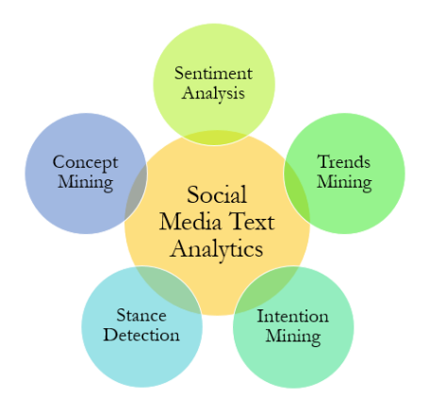
Purpose of Text Analytics

Slide 9
Sentiment Analysis
Sentiment analysis involves categorizing social media text as positive, negative, or neutral. It is often used to understand how customers feel about a product, service, or issue.
Tools like Semantria use algorithms to identify sentiment-bearing phrases in text and assign them a score based on a logarithmic scale.
Scores are then combined to determine the overall sentiment of a document or sentence.
Sentiment analysis can provide valuable insights into the emotions and opinions of social media users.

Slide 10
Sentiment Analysis
Step 1: It breaks the document into its basic parts of speech, called POS tags, which identify the structural elements of a sentence (e.g. nouns, adjectives,verbs, and adverbs).
Step 2: Algorithms identify sentiment-bearing phrases like “terrible service” or “cool atmosphere.”
Step 3: Each sentiment-bearing phrase earns a score based on a logarithmic scale ranging from negative ten to positive ten.
Step 4: Next, the scores are combined to determine the overall sentiment of the document or sentence. Document scores range between negative two and positive two. For example, to calculate the sentiment of a phrase such as “terrible service,” Semantria uses search engine queries similar to the following:
“(Terrible service) near (good, wonderful, spectacular)” “(Terrible service) near (bad, horrible, awful)”
Each result is added to a hit count; these are then combined using a mathematical operation called “log odds ratio” to determine the final score of a given phrase.

Slide 11

Intention Mining
Intention mining involves discovering users' intentions (such as desire, wish, or intention to buy) from natural language social media text.
Companies can use intention mining to identify potential customers and service existing customers who have issues with a product.
Examples of intention-bearing phrases include "buy," "purchase," and "quit."
Tools like Semantria can be used to mine intentions from social media text.
Intention mining can provide valuable insights into the needs and desires of social media users.

Slide 12
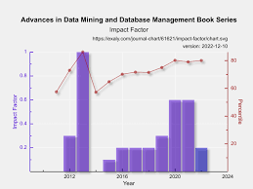
Trends Mining
Trends mining, also known as predictive analytics, uses large amounts of historical and real-time social media data to predict future events.
It involves identifying patterns and trends in social media data to improve products, services, or customer satisfaction.
Techniques used in trends mining include machine learning, data mining, and social network analysis.
Predictive analytics using business data has been used in various industries, but social media predictive analytics is still an emerging practice.
Trends mining can provide valuable insights for businesses and organizations looking to anticipate the needs and desires of their customers.

Slide 13
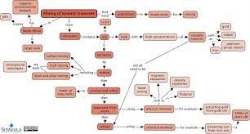
Concept Mining
Concept mining is a method for extracting ideas and concepts from documents.
It is used to classify, cluster, and rank these ideas.
Concept mining is different from text mining, which focuses on extracting specific information rather than broader ideas and concepts.
Examples of documents that can be analyzed using concept mining include social media text, web pages, and news transcripts.

Slide 14
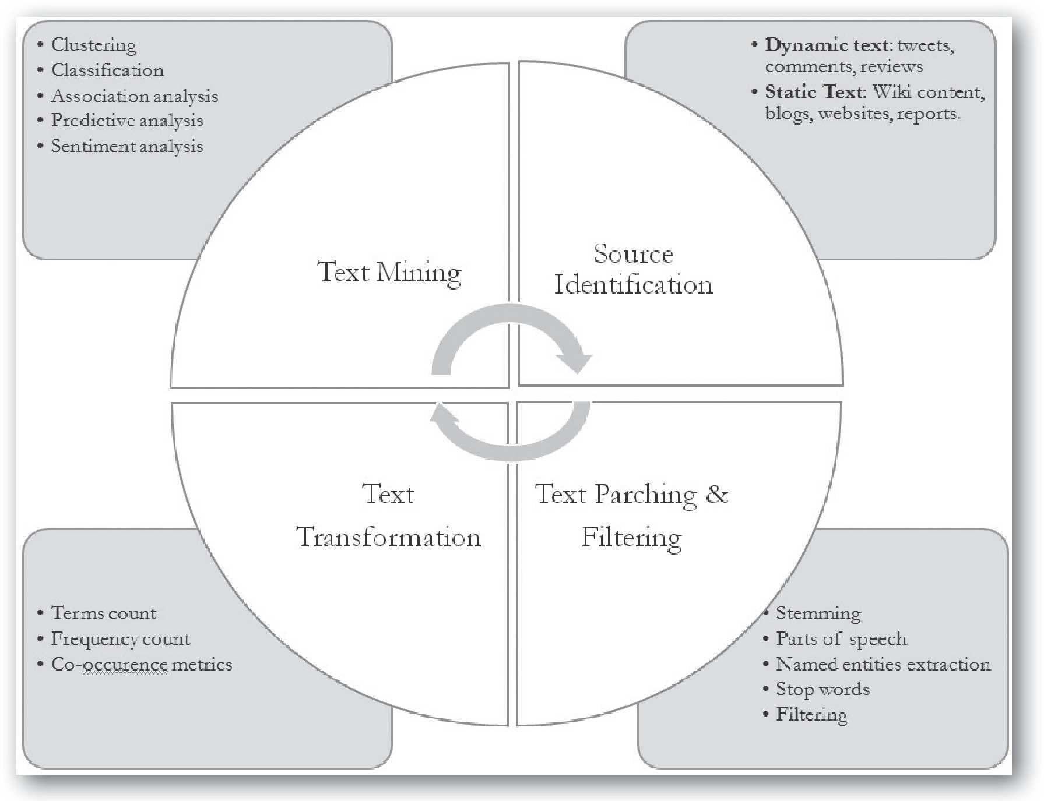
Steps in Text Analytics

Slide 15
Text Analytics Tools
Discovertext: Discovertext (http://discovertext.com/) is a powerful platform for collecting, cleaning, and analyzing text and social media data streams.
Lexalytics: Lexalytics (http://www.lexalytics.com/) is a social media text and semantic analysis tool for social media platforms, including Twitter, Facebook, blogs, etc.
Tweet Archivist: Tweet Archivist (https://www.tweetarchivist.com/) is focused on searching, archiving, analyzing, and visualizing tweets based on a search term
or hashtag (#).
Twitonomy: Twitonomy (https://www.twitonomy.com/) is a Twitter analytics tool for getting detailed and visual analytics on tweets, retweets, replies, mentions, hashtags, followers, etc.
Netlytic: Netlytic (https://netlytic.org) is a cloud-based text and social network analytics platform for social media text that discovers social networks from online conversations on social media sites.
LIWC: Linguistic Inquiry and Word Count (LIWC) is a text analysis tool for analyzing emotional, cognitive, structural, and process components present in individuals’ verbal and written speech samples: http://www.liwc.net/
Voyant: Voyant (http://voyant-tools.org/) is a web-based text reading and analysis. With Voyant, a body of text can be read from a file or directly exported from a website.

Slide 16
Case Study
FlyerTalk.com, is a company that specializes in products and services for frequent travelers. The website features chat boards and discussions about the latest travel information and loyalty programs for airlines and hotels.
FlyerTalk.com wanted to analyze the large amount of customer feedback and opinions expressed on their website.
They used the SPSS software for analysis
Data collection involved using web scraping techniques to crawl and scrape the website for specific information, and store and screen scrape the data into a structured format.
Text coding and categorization involved assigning codes and categories to the data to make it easier to analyze.
Finally, text mining and visualization involved using statistical analysis and visual representation of the data to draw insights and conclusions.F

Slide 17
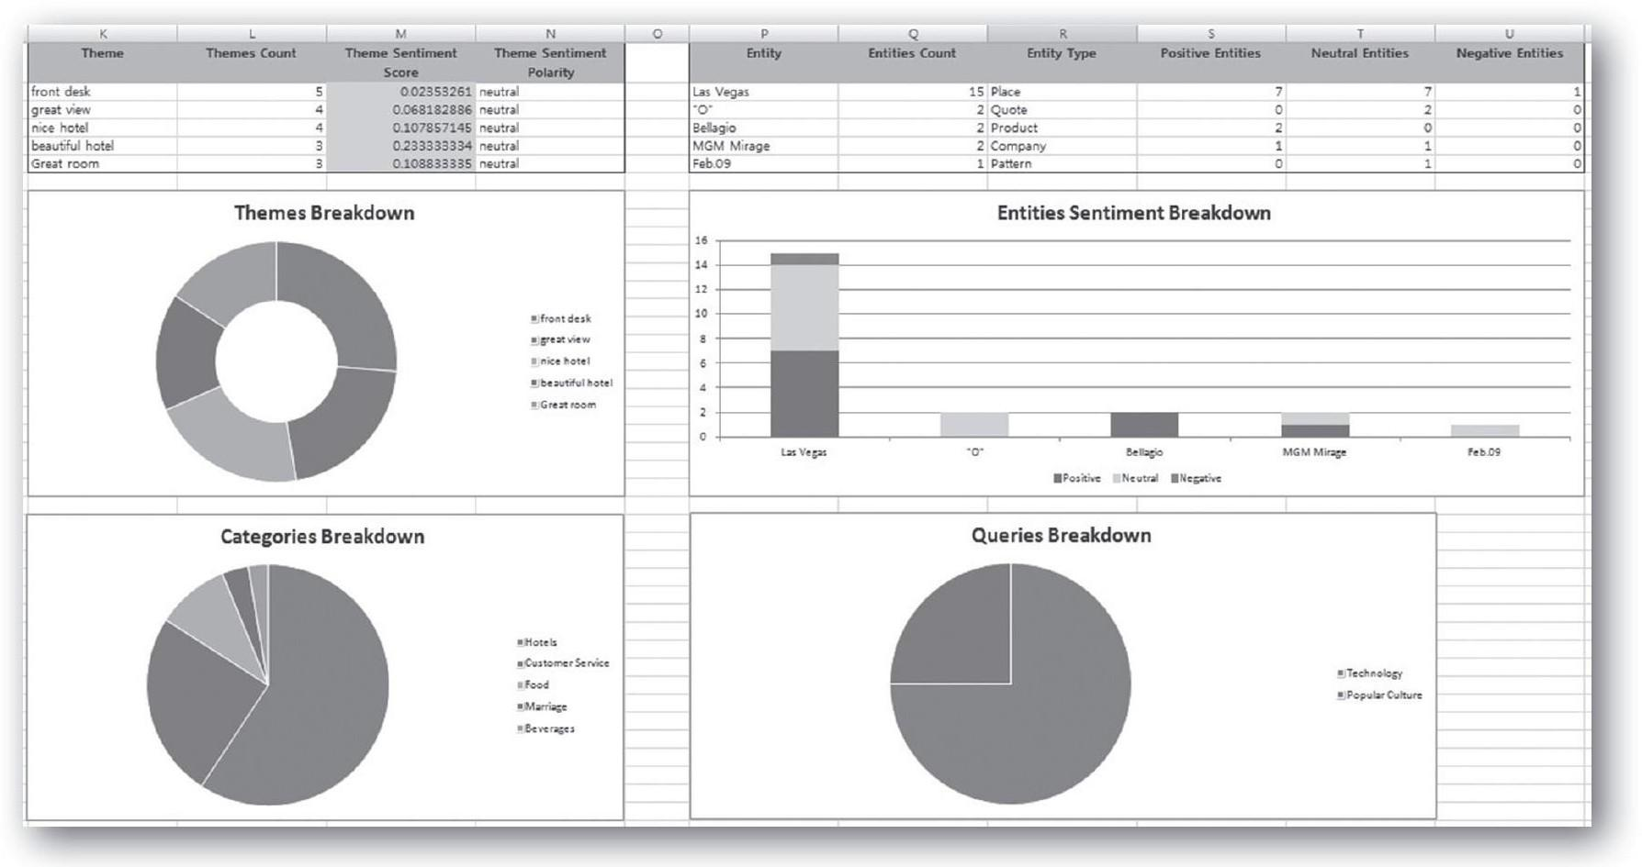
Semantria detailed analysis report

Slide 18
Questions
What is text analytics, and why it is useful?
Differentiate between static and dynamic social media text.
Discuss different social media texts.
Explain the four main purposes of social media text analytics.
Explain the typical social media text analysis steps.
Tool - SPSS-https://www.ibm.com/account/reg/in-en/signup?formid=urx-19774

Slide 19
Thank You !!

